Slide 1
LOGICAL MODELLING
CT026-3-1-Systems Analysis and Design

Slide 2
Topic Learning Outcomes
At the end of this topic, you should be able to:
1. Explain the purpose of Data Flow Diagrams
2. Draw a context diagram

Slide 3
Contents & Structure
Data Flow Diagrams
Introduction
Purpose
Steps in developing Data Flow Diagrams
Symbols
Context Diagram

Slide 4
Key terms you must be able to use
If you have mastered this topic, you should be able to use the following terms correctly in your assignments and exams:
Context Diagram
External Entities
Processes
Data Flows

Slide 5
Recap From Last Lesson
List six (6) example of fact-finding techniques?

Slide 6
Purpose of Data Flow Diagrams
to show the processes that data undergo in a system
to show how data moves and changes through an information system in a graphical, top-down fashion
to produce a logical model of an information system in a simple, direct way

Slide 7
Quick Review Question
What is the purpose of the data flow diagram?

Slide 8
Components of DFDs
External Entities / Source & Sink
Process
Data Flow
Data Store

Slide 9
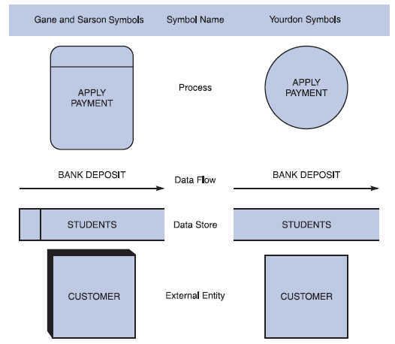
Symbols in DFDs

Slide 10
External Entities / Source & Sink
Also known as terminators
Is a person, dept, outside organization or other information system that provides data to the system or receives data from the system
May be a source, a sink or both

Slide 11
External Entities / Source & Sink
Source
an external entity that supplies data
Also known as origin
Sink
an external entity that receives data
Also known as destination
Is named using the singular form of the name

Slide 12
Process
Also called a bubble or transform
Modifies or changes data from one form to another form
Is named to identify the function it accomplishes
A diagram should have no more than nine process symbols
Name consists of an active verb followed by a singular noun

Slide 13
Data Flow
represents the transfer of data among data stores, sources or sinks, and processes
can represent a specific piece of data – employee names or a set of data – class list – student numbers & student names
detailed contents of a data flow are not shown in a DFD
line can be curved or straight
name consists of adjectives and a singular noun

Slide 14
Data Store
is a data repository
is used when the system must store data because one or more processes need to use the stored data a later time
only processes may connect to data stores
name is a plural name consisting of adjectives and a noun

Slide 15
Quick Review Question
What are the notations for:
external entities?
data store?
data flow diagrams?
processes?

Slide 16
Context Diagram
A data flow diagram (DFD) of the scope of an organizational system that shows the system boundaries, external entities that interact with the system and the major information flows between the entities and the system.

Slide 17
Context Diagram
is a top-level view of the information system
has one process symbol representing the entire information system
has the external entities around the perimeter of the page
use data flow to connect the external entities with the process
do not show data store

Slide 18
Context Diagram
Step 1 : Identify Process - name of the system.
Step 2 : Identify External Entities – stakeholders, and draw it around the perimeter of the page.
Step 3 : Identify Data Flows
** Remember the Rules:
Follow naming conventions.
Do not represent detail data flows as from entity to entity.

Slide 19
Creating a Set of DFDs
Guidelines for Drawing DFDs
Draw the context diagram so that it fits on one page
Use the name of the information system as the process name in the context diagram
Use unique names within each set of symbols
Do not cross lines
Provide a unique name and reference number for each process
Ensure that the model is accurate, easy to understand, and meets the needs of its users

Slide 20
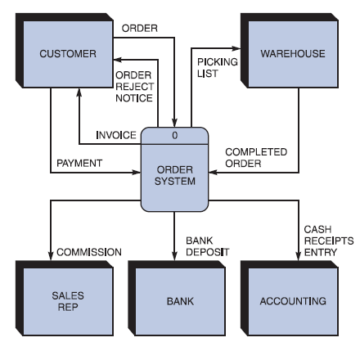
Creating a Set of DFDs
Step 1: Draw a Context Diagram
FIGURE 5-13 Context diagram DFD for an order system
20

Slide 21
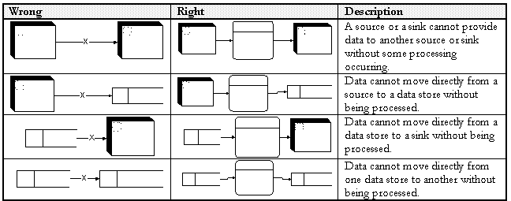
Basic Data Flow Diagramming Rules

Slide 22
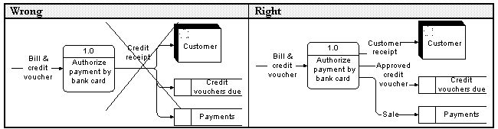
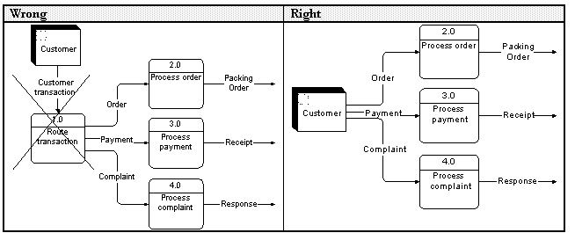
Common Mistakes in DFD
Slide 21 (of 21)

Slide 23
Learning Outcomes
By the end of this lecture, YOU should be able to :
Draw a level 0 and 1 data flow diagram based on a context diagram or a given case study.

Slide 24
Key Terms you must be able to use
If you have mastered this topic, you should be able to use the following terms correctly in your assignments and exams:
- DFD
- Process
- External entities
- Data flow
- Data store

Slide 25
Lower-level diagrams
Also called child diagram
Is exploded from parent diagram
When drawn, should be
leveled
also called exploded, partitioned and decomposed
drawn in a series of increasingly detailed diagrams until desired degree of detail is reached
balanced
maintain consistency among the entire series of diagrams

Slide 26
Step(s) to Draw Data Flow Diagram Level 0
Step 1 : Identify related process – main functionalities/ sub-modules
Step 2 : Identify Data Flows to/from External Entities to/from identified processes, at the same time identify Data Store needed

Slide 27
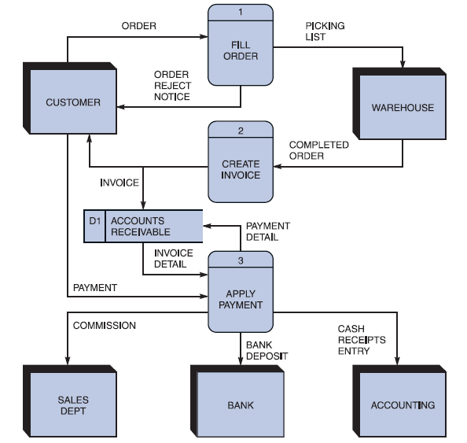
Creating Level 0 DFD
Step 2: Draw a Diagram 0 DFD
If same data flows in both directions, you can use a double-headed arrow
Diagram 0 is an exploded view of process 0
Parent diagram
Child diagram
FIGURE 5-16 Diagram 0 DFD for the order system
27

Slide 28
Diagramming Mistakes in DFD
A second class of DFD mistakes arise when the outputs from one processing step do not match its inputs.
It is not A processing step may have input flows but no output flows. This situation is sometimes called a black hole.
A processing step may have output flows but no input flows. This situation is sometimes called a miracle.
A processing step may have outputs that are greater than the sum of its inputs - e.g., its inputs could not produce the output shown. This situation is sometimes referred to as a grey hole.
hard to list situations in which this might occur:

Slide 29

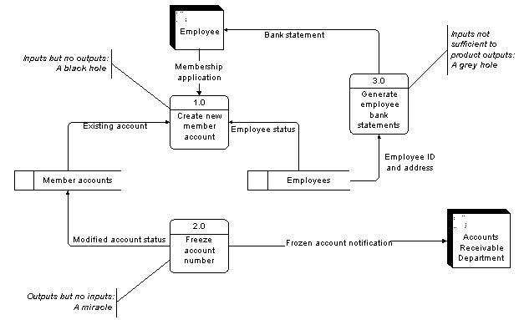
Diagramming Mistakes in DFD

Slide 30
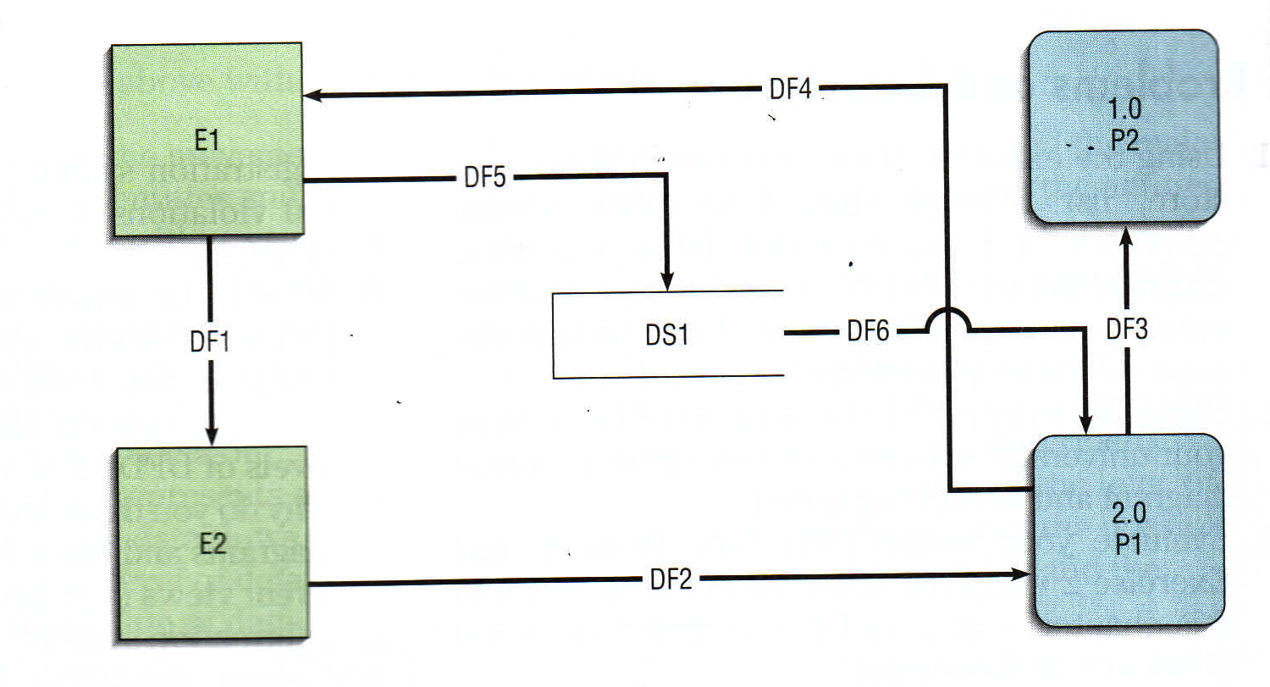
Let’s find the mistakes!

Slide 31

Let’s find the mistakes!
Process 1.0 (P2) has only inputs, making it a “black hole”.
Data flow DF5 should not move directly from source E1 to data store DS1 without first going through a process.
Data flow DF1 should not move directly from source E1 to sink E2 without first going through a process.

Slide 32
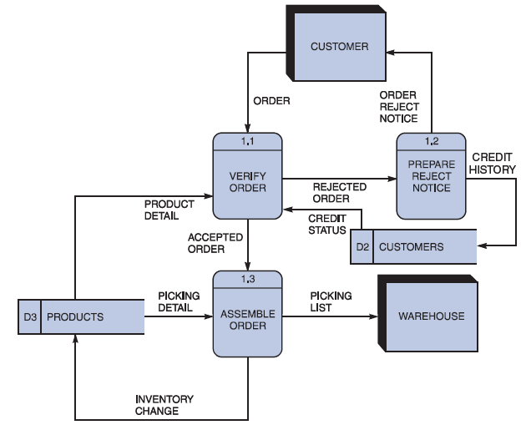
Creating Level 1 DFD
Step 3: Draw the Lower Level Diagrams
Must use leveling and balancing techniques
Leveling examples
Uses a series of increasingly detailed DFDs to describe an information system
Exploding, partitioning, or decomposing
FIGURE 5-17 Diagram 1 DFD shows details of the FILLORDER process in the order system

Slide 33
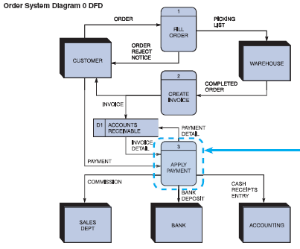
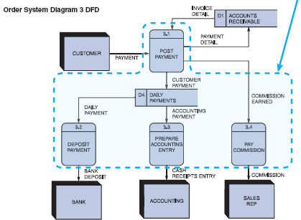
Creating Level 1 DFD
FIGURE 5-19 The order system diagram 0 is shown at the top of the figure, and exploded diagram 3 DFD (for the APPLY PAYMENT process) is shown at the bottom. The two DFDs are balanced because the child diagram at the bottom has the same input and output flows as the parent process 3 shown at the top
33

Slide 34
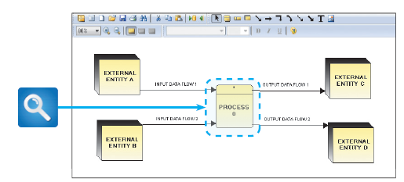
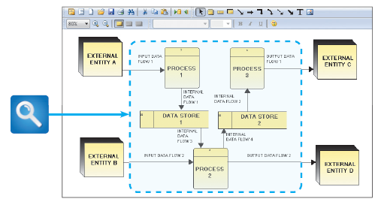
Creating Level 1 DFD
FIGURE 5-20 Example of a parent DFD diagram, showing process 0 as a black box
FIGURE 5-21 In the next level of detail, the process 0 black box reveals three processes, two data stores, and four internal data flows — all of which are shown inside the dashed line
34

Slide 35
Process Decomposition
1.0
Sale
1.1
Record Order
1.2
Receive Payment
2.0
Production
2.1
Serve Product
2.2
Produce Product
2.3
Store
Product
0.0
Lemonade System
3.0
Procure-ment
3.1
Produce Purchase Order
3.2
Receive Items
3.3
Pay Vendor
4.0
Payroll
4.1
Record Time Worked
4.2
Calculate Payroll
4.3
Pay Employee
Context Level
Level 0
Level 1

Slide 36
Draw Context Diagram
Case Study#1: Kitchen Gadgets sells a line of high-quality kitchen utensils and gadgets. When customer place orders, the system checks to see if the items are in stock, issues a status message to the customer, and generates a shipping order to the warehouse, and the warehouse will fills the order. When the order is shipped, the customer is billed. The system also produces inventory report to the accounting department.
**A system analyst should be able to complete the incomplete case study.

Slide 37
Step 1: Identify the process name
Case Study#1: Kitchen Gadgets sells a line of high-quality kitchen utensils and gadgets. When customer place orders, the system checks to see if the items are in stock, issues a status message to the customer, and generates a shipping order to the warehouse, and the warehouse will fills the order. When the order is shipped, the customer is billed. The system also produces inventory report to the accounting department.
**A system analyst should be able to complete the incomplete case study.

Slide 38
Step 2: Identify the external entities
Case Study#1: Kitchen Gadgets sells a line of high-quality kitchen utensils and gadgets. When customer place orders, the system checks to see if the items are in stock, issues a status message to the customer, and generates a shipping order to the warehouse, and the warehouse will fills the order. When the order is shipped, the customer is billed. The system also produces inventory report to the accounting department.
**A system analyst should be able to complete the incomplete case study.

Slide 39
Step 3: Identify the data flows
Case Study#1: Kitchen Gadgets sells a line of high-quality kitchen utensils and gadgets. When customer place orders, the system checks to see if the items are in stock, issues a status message to the customer, and generates a shipping order to the warehouse, and the warehouse will fills the order. When the order is shipped, the customer is billed. The system also produces inventory report to the accounting department.
**A system analyst should be able to complete the incomplete case study.

Slide 40
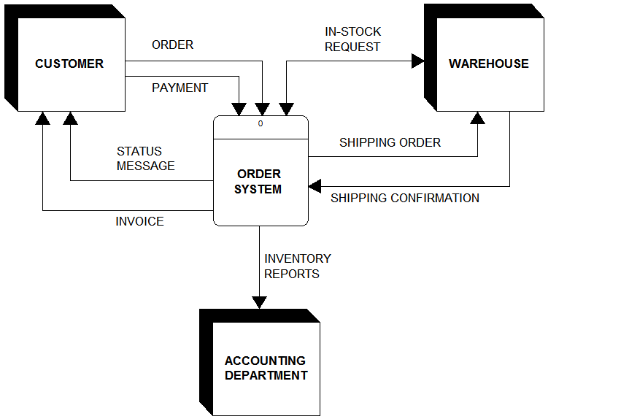
Suggestion of Context Diagram Case Study#1
**A system analyst should be able to complete the incomplete case study.
Slide 40 (of

Slide 41
Step 1: Identify process(s)
Case Study#1: Kitchen Gadgets sells a line of high-quality kitchen utensils and gadgets. When customer place orders, the system checks to see if the items are in stock, issues a status message to the customer, and generates a shipping order to the warehouse, and the warehouse will fills the order. When the order is shipped, the customer is billed. The system also produces inventory report to the accounting department.
**To draw DFD Level 0, imagination is needed to complete any incomplete narration in case study.

Slide 42
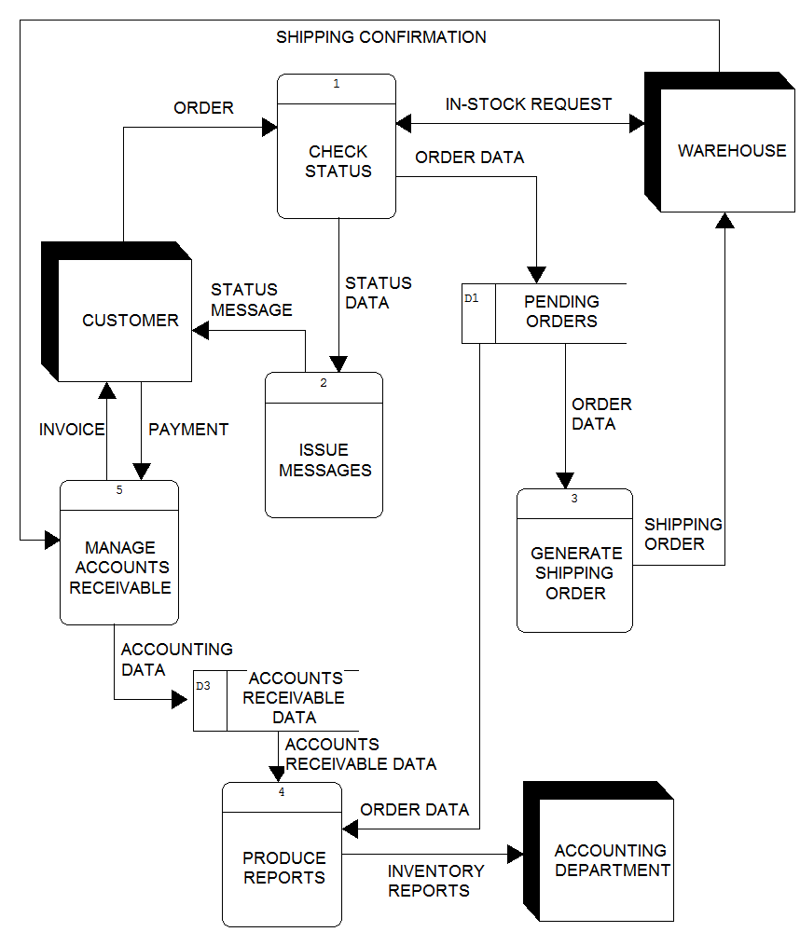
Suggestion of Level 0 DFD Case Study#1
Slide 42 (of

Slide 43
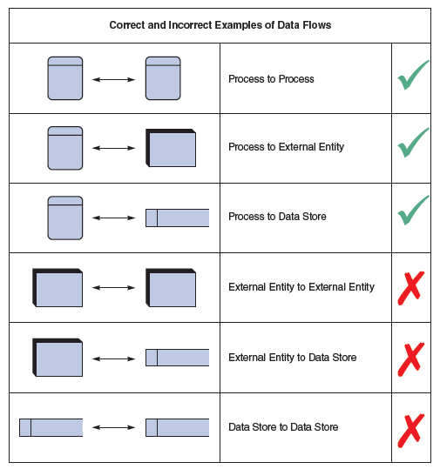
Creating a Set of DFDs
Keep in mind:
All flow lines must be labeled
Large processes can be broken down into smaller components in lower level of DFD
FIGURE 5-11 Examples of correct and incorrect uses of data flows

Slide 44
Summary
Data Flow Diagrams
Levels
Level 0
Level 1
Rules governing the creation of DFDs

Slide 45
Question and Answer Session
Q & A

Slide 46
What To Expect Next Week
In Class
Preparation for Class
Data Dictionary
What is a Data Dictionary?
Use of a Data Dictionary
Contents of a Data Dictionary
Data Description
Data Structure
Data Element
Download the slide and study for the next chapter.

